Slide 1
Project 1: Integration of Mergesort & Insertion Sort
Class Group: SS7
Team: 1
Members: Eugene Foo Yu Kai , Hsieh Boh Yang, Leung Chun Kit Andrew
Notes:
Link to Python Code & Graphs: https://colab.research.google.com/drive/1afZJYYOFvo73Wt-t3c3Spt0HRxdfqqGl#scrollTo=D5Z4neXNfVFd

Slide 2
(a) Algorithm implementation

Slide 3
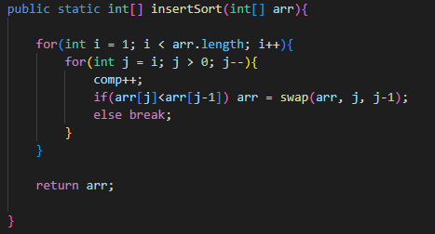
Insertion Sort
Notes:
For insertion sort, we have two loops, where the outer loops loops through each individual element in the array
The inner loop then loops from the current element in the array being processed and compares it with the previous sorted elements, until no swap occurs and the new element is sorted

Slide 4
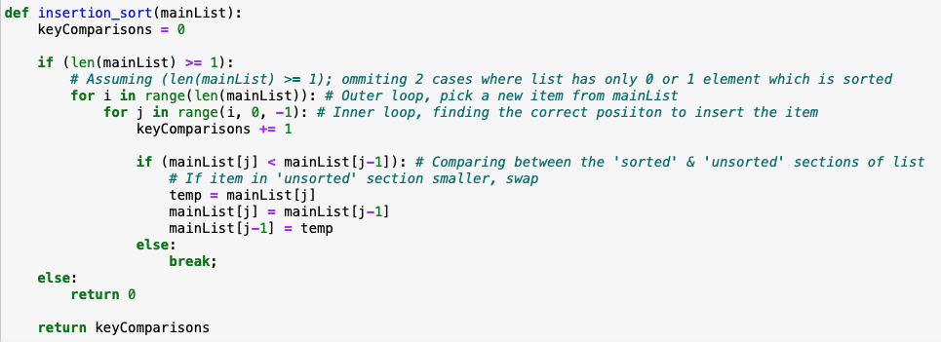
Insertion Sort
Notes:
For insertion sort, we have two loops, where the outer loops loops through each individual element in the array
The inner loop then loops from the current element in the array being processed and compares it with the previous sorted elements, until no swap occurs and the new element is sorted

Slide 5
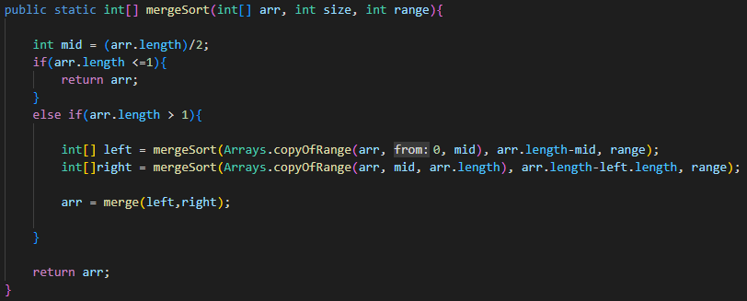
Merge Sort
Notes:
For Merge Sort, we first recursively divide the array into halves until they are of one element each, then combining them with the operation merge to return the sorted algorithm

Slide 6
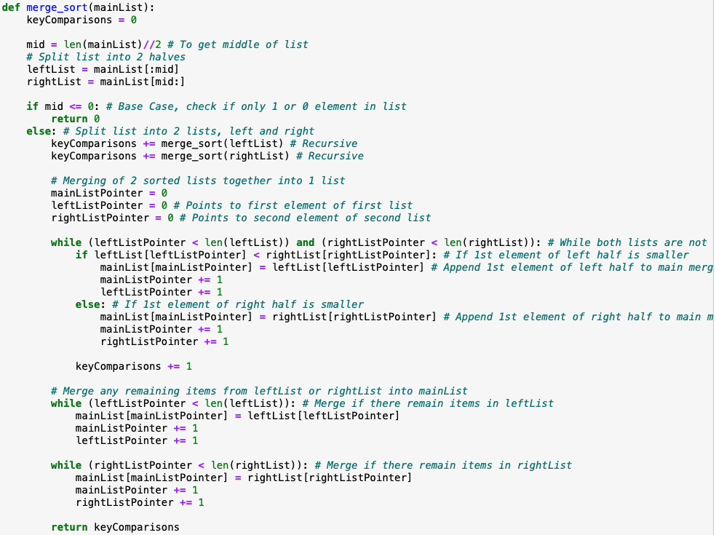
Merge Sort
Notes:
For Merge Sort, we first recursively divide the array into halves until they are of one element each, then combining them with the operation merge to return the sorted algorithm

Slide 7
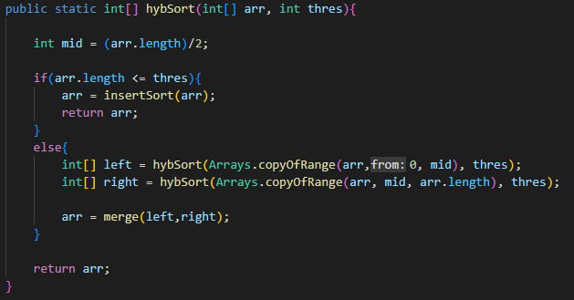
Hybrid Sort
Notes:
Above is the implementation of Hybrid Sort
The function takes an integer array (arr) and threshold (S) as an input argument and returns the sorted integer array as output
Firstly, the algorithm finds the midpoint of the array and checks if the array is smaller than the threshold size with comparison arr.length <= thres
If the comparison returns true, an insertion sort is performed, returning the sorted array
Otherwise, the standard merge sort operation is performed, where the array is recursively divided into halves, until it reaches the threshold value
Then, the two halves of arrays returned by the recursive calls are the combined using the operation merge, to form the final sorted array

Slide 8
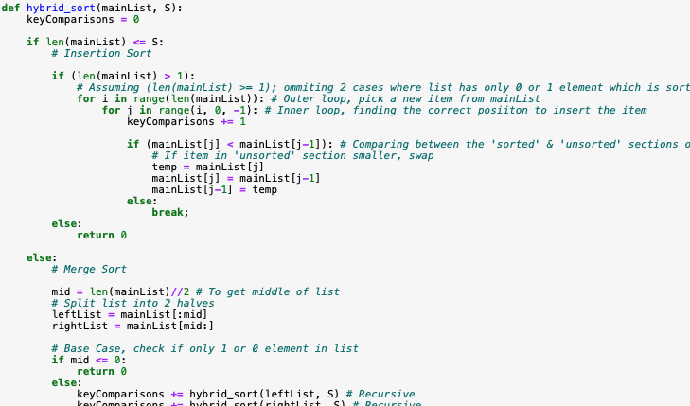
Hybrid Sort
def hybrid_sort(mainList, S): keyComparisons = 0 if len(mainList) <= S: # Insertion Sort else: # Merge Sort
Notes:
Above is the implementation of Hybrid Sort
The function takes an integer array (arr) and threshold (S) as an input argument and returns the sorted integer array as output
Firstly, the algorithm finds the midpoint of the array and checks if the array is smaller than the threshold size with comparison arr.length <= thres
If the comparison returns true, an insertion sort is performed, returning the sorted array
Otherwise, the standard merge sort operation is performed, where the array is recursively divided into halves, until it reaches the threshold value
Then, the two halves of arrays returned by the recursive calls are the combined using the operation merge, to form the final sorted array

Slide 9
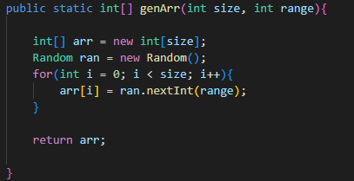
(b) Generate input data
Notes:
The function genArr creates random arrays using the arguments size and range, and Random object ran to fill the array with elements within the range
The array is then returned

Slide 10

(b) Generate input data
Notes:
The function genArr creates random arrays using the arguments size and range, and Random object ran to fill the array with elements within the range
The array is then returned

Slide 11
(c) Analyze time complexity (Theoretical)
Sorting Algo | Best Case | Average Case | Worst Case
Insertion Sort | O(n) | O(n²) | O(n²)
Merge Sort | O(n log n) | O(n log n) | O(n log n)
Notes:
For insertion sort, the outer for loop will always be executed for n – 1 iterations, where n is the number of input records. In the best case, on each iteration of the outer for loop, it only needs to be compared with its neighbour on the left side, and we don’t do any swaps. So the best case would be O(n).

Slide 12
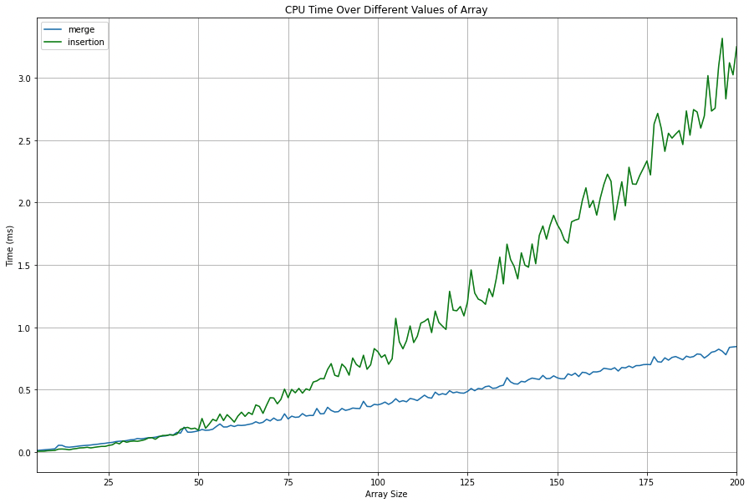
Rationale behind Hybrid Sort
Notes:
We can observe a cross-over in Execution time between Merge Sort and Insertion Sort.
With a smaller array size, Insertion Sort will be faster than Merge Sort. However, as array size increases, program runtime / number of key comparisons increases exponentially
Hence, for large array sizes, we will use the merge sort algorithm, and we will need to have a Hybrid Sort to switch over to Insertion Sort from Merge Sort when the subarrays are smaller than a certain Threshold.

Slide 13
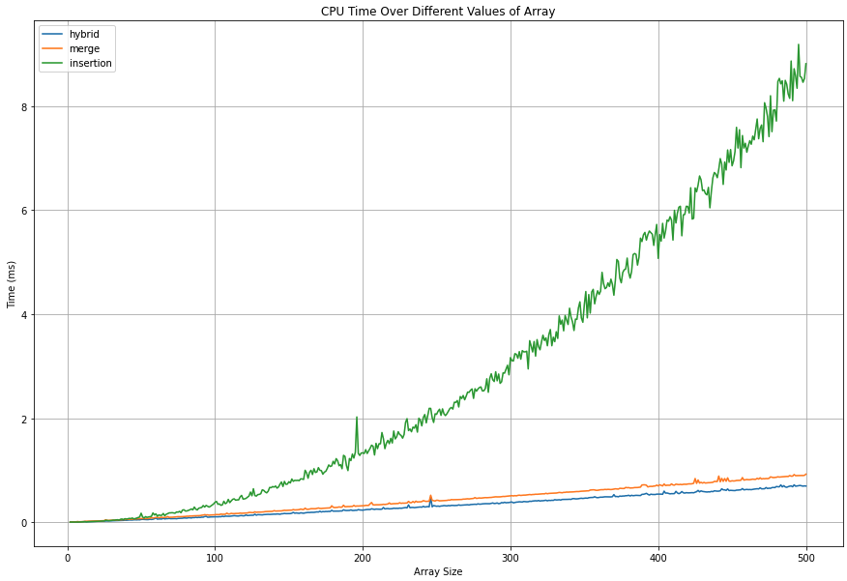
Performance of Hybrid Sort against Merge Sort and Insertion Sort
Notes:
From this slide we can see that as array size increases, the algorithm runtime increases exponentially for insertion sort since the average case time complexity is n squared. As for merge sort and hybrid sort, the algo runtime increases very close to linearly.The performance of Hybrid sort is slightly better than merge sort since insertion sort is more efficient at smaller subarray sizes as compared to a pure merge sort algorithm

Slide 14
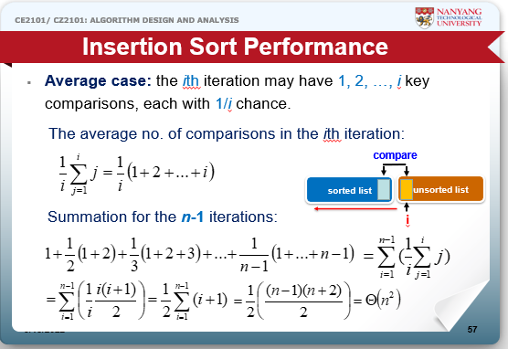

Slide 15
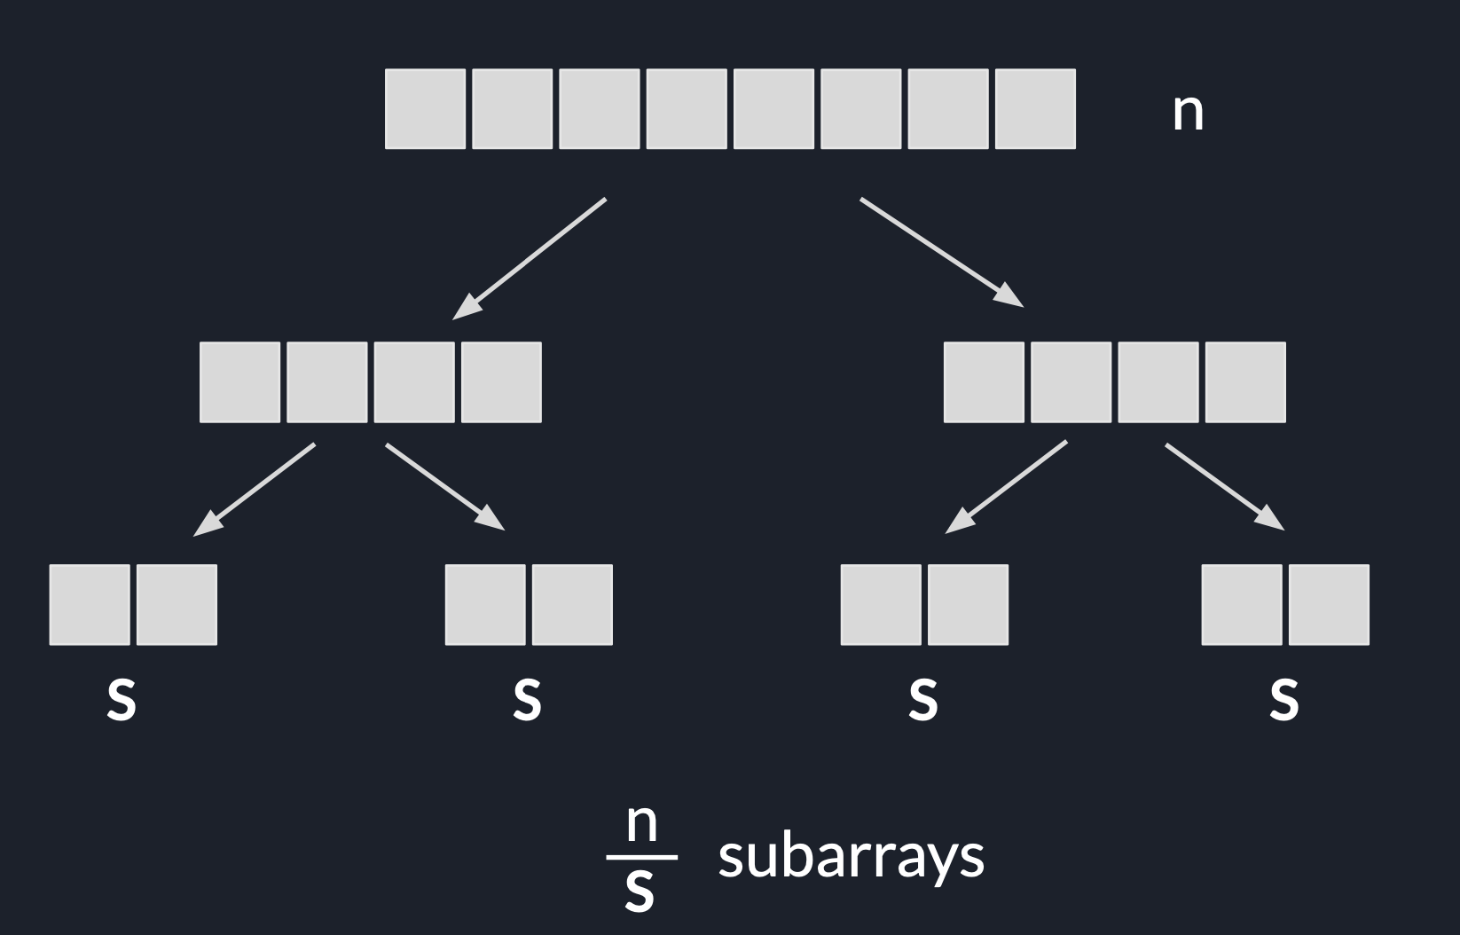
(c) Hybrid Sort Time Complexity
Notes:
By looking at this tree, we can see that by dividing the array of n length into subarrays of s length, the number of subarrays would be n/s, while the height of the tree can be given by the expression log(n/s)

Slide 16
Derivation of Time Complexity
Insertion(s)
n/s [ Insertion(s) ]
n/s [ Insertion(s) ] + n log n/s
Insertion Sort Best Case: ( s )
= O( n + n log n/s )
Insertion Sort Average/Worst Case: ( s² )
= O( ns + n log n/s )
Notes:
First we consider the Insertion sort past the threshold.
The time complexity of this would be the complexity of insertion sort, with s inputs hence: ( Insertion(s) )
Since we are doing Insertion sort over the n/s subarrays, the combined complexity would be: ( n/s [ Insertion(s) ] )
Next, we add the complexity of Merge sort, in which we are performing the merge operation n values, and the height of the recursion tree would be log n/s , the complexity of this part would be n log n/s
Hence, we can combine the two with the cases in which Insertion sort has different time complexities for different cases
In the best case of insertion sort, where the subarray is already sorted, each subarray pass would take O(s), giving the complete expression of O(n + n log n/s)
In the average to worst case, each pass would take O(s^2), giving the complete expression of O(ns + n log n/s)

Slide 17
(c) Analyze time complexity (Theoretical)
Sorting Algo | Best Case | Average Case | Worst Case
Insertion Sort | O(n) | O(n²) | O(n²)
Merge Sort | O(n log n) | O(n log n) | O(n log n)
Hybrid Sort | O(n + n log n/s ) | O(ns + n log n/s) | O(ns + n log n/s)
Notes:
First we consider the Insertion sort past the threshold.
The time complexity of this would be the complexity of insertion sort, with s inputs hence: ( Insertion(s) )
Since we are doing Insertion sort over the n/s subarrays, the combined complexity would be: ( n/s [ Insertion(s) ] )
Next, we add the complexity of Merge sort, in which we are performing the merge operation n times, and the height of the recursion tree would be log n/s , the complexity of this part would be n log n/s
Hence, we can combine the two with the cases in which Insertion sort has different time complexities for different cases
In the best case, where the subarray is already sorted, each subarray pass would take O(s), giving the complete expression of O(n + n log n/s)
In the average to worst case, each pass would take O(s^2), giving the complete expression of O(ns + n log n/s)

Slide 18
(c) Analyze time complexity (Empirically)
Notes:
Compare our empirical data against the theoretical analysis to see if there are any discrepancies

Slide 19
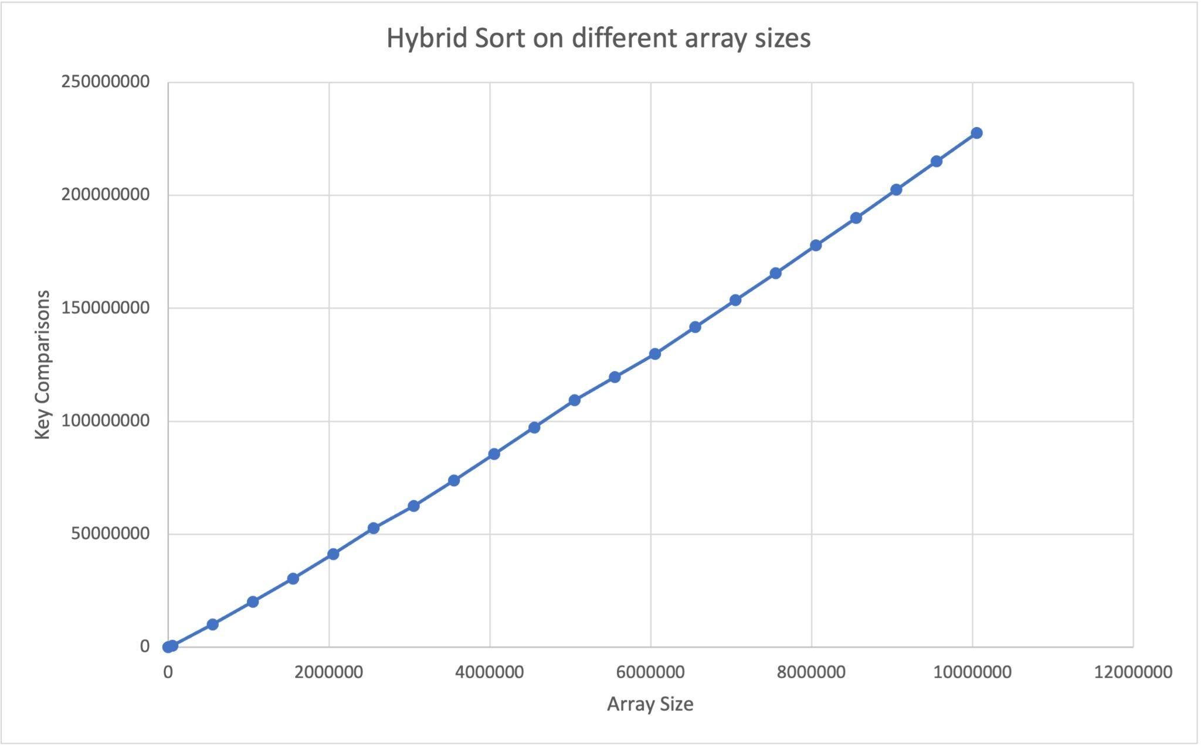
(c) i) HybridSort on Dataset with fixed S value (10)
Add graph of number of key comparisons over different sizes of input
Notes:
S fixed at 10, average key comparisons over varying array size
This graph shows that the time complexity of Hybrid Sort is very close to linear time on average, which is much more efficient than insertion sort on average, which is exponential.

Slide 20
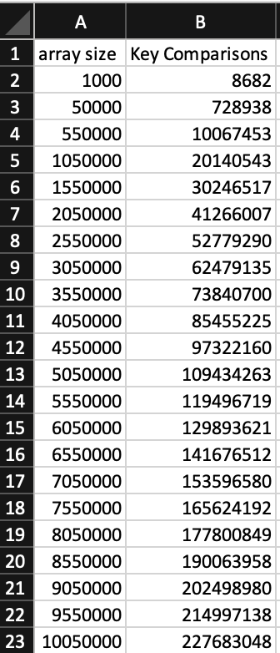
(c) i) HybridSort on Dataset with fixed S value (10)

Slide 21
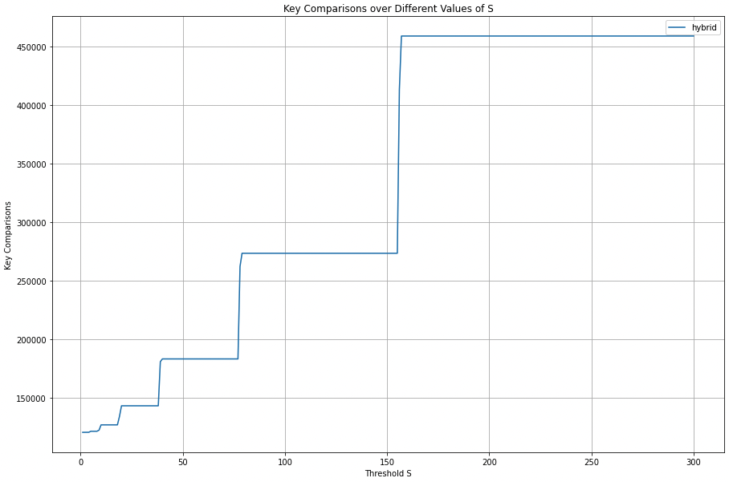
(c) ii) HybridSort on Dataset with input size fixed
Add graph of number of key comparisons over different values of S

Slide 22
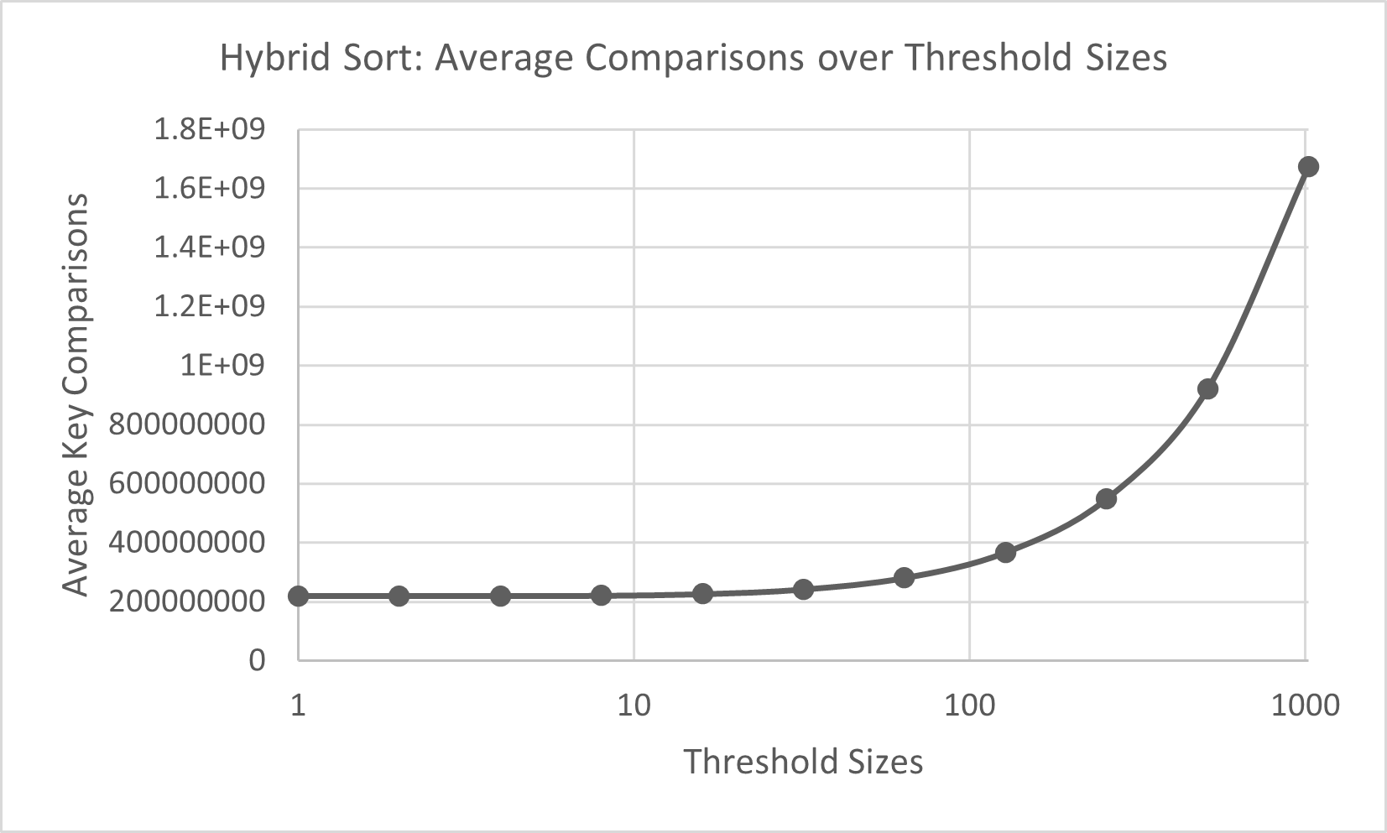
(c) ii) HybridSort on Dataset with input size fixed
Add graph of number of key comparisons over different values of S

Slide 23
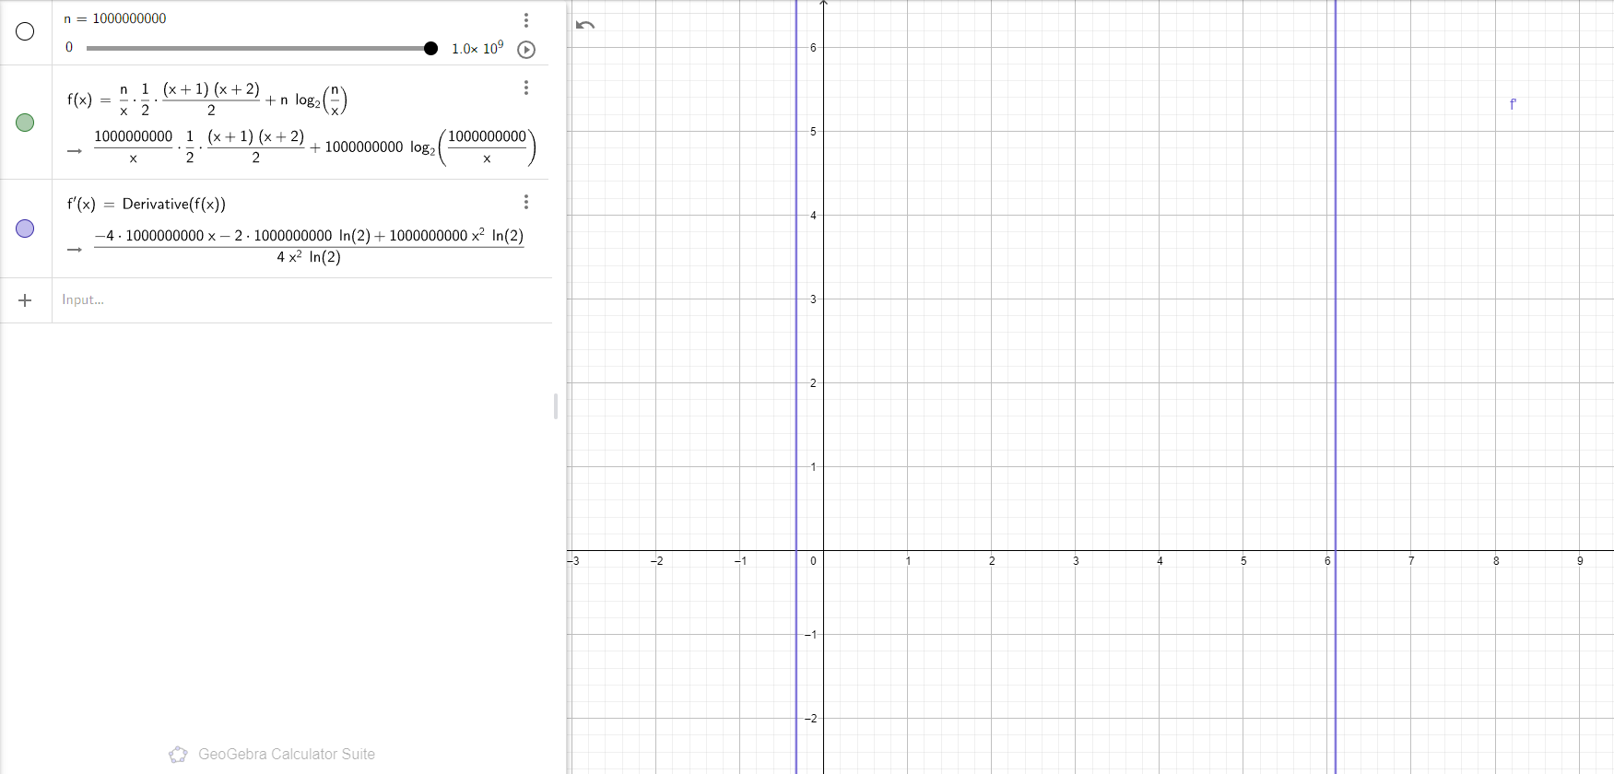
S ≈ 6
Notes:
By using the time complexity from our previous analysis and using the summation of average comparisons done in insertion sort, we can derive an approximate equation to find the average comparisons
By differentiating the formula, we find that the graph intersects the x axis at around x = 6, meaning that this would be the optimal value for threshold s

Slide 24
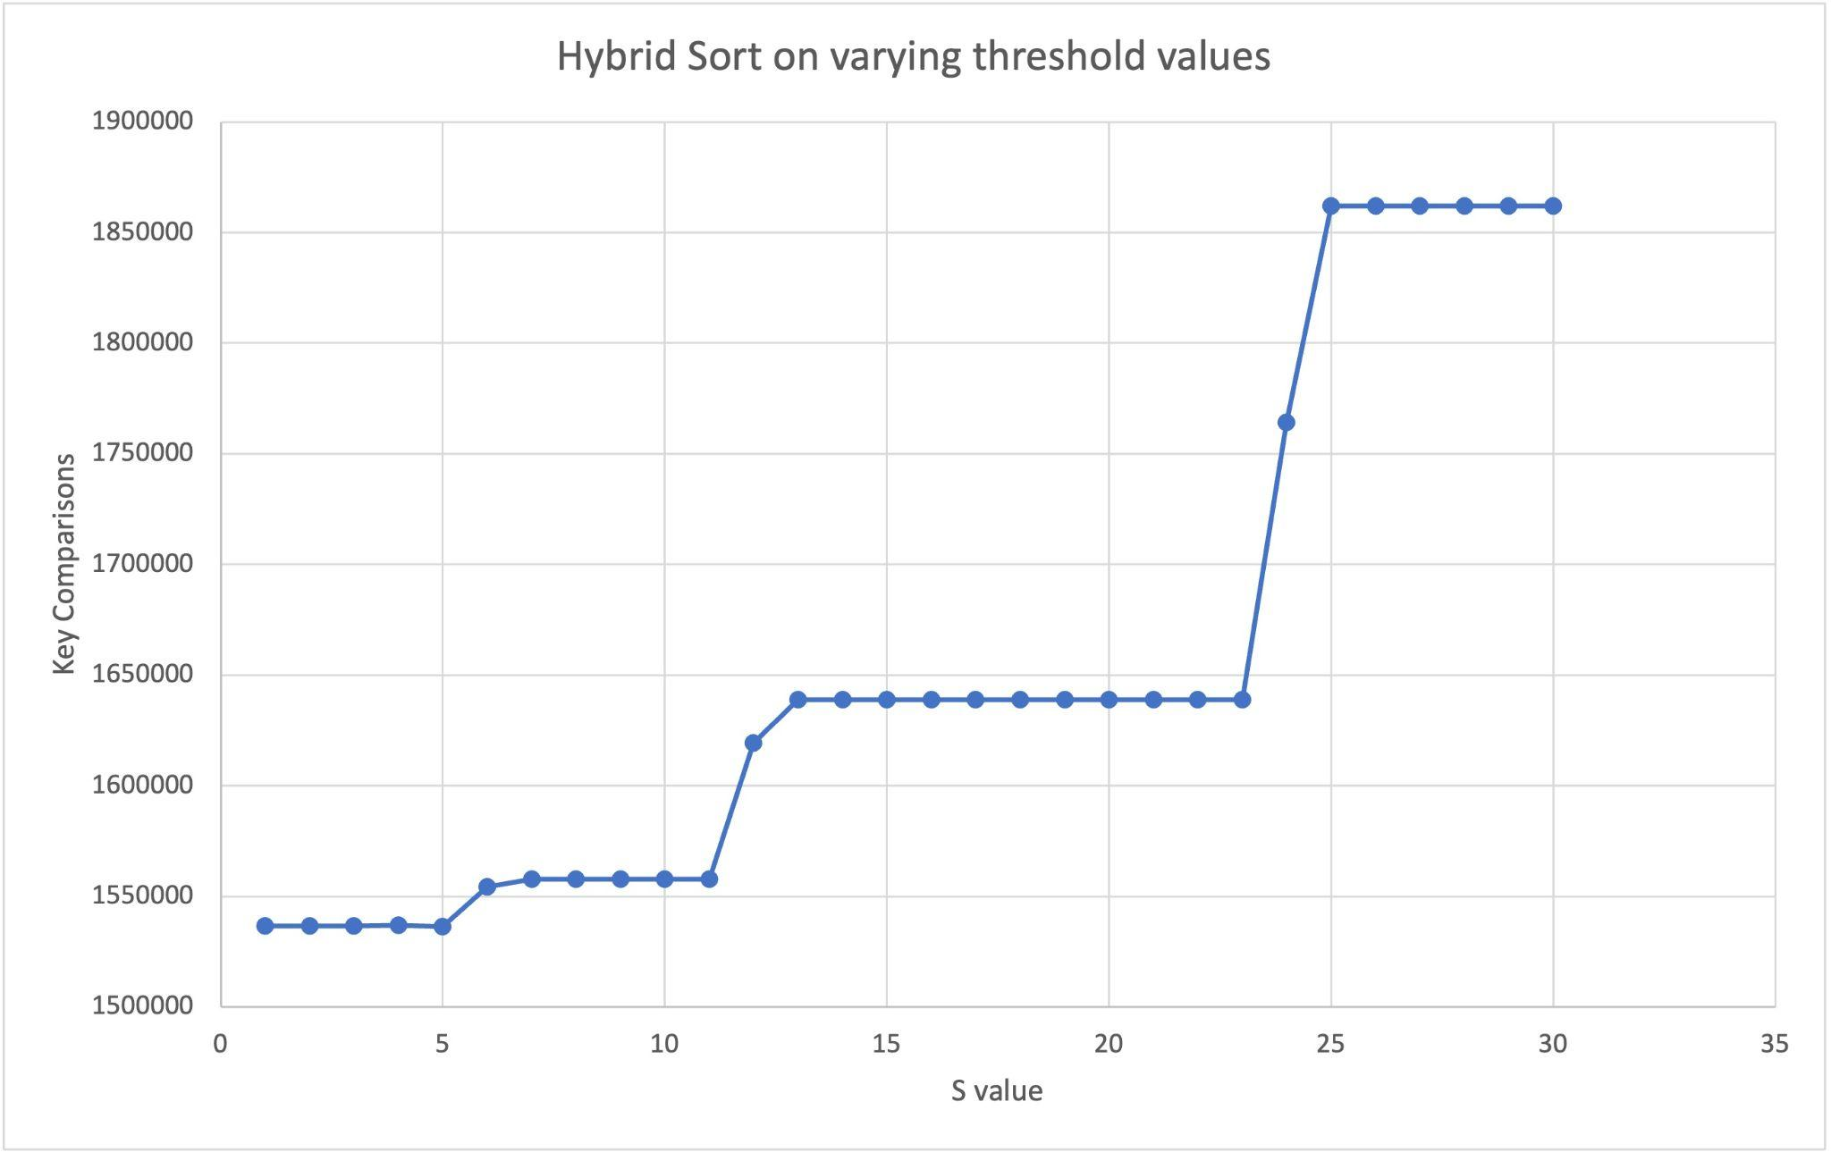
(c) ii) HybridSort on Dataset with input size fixed (100,000)
Notes:
According to empirical data, the optimal value of S is 5, which is very close to the theoretical value.

Slide 25
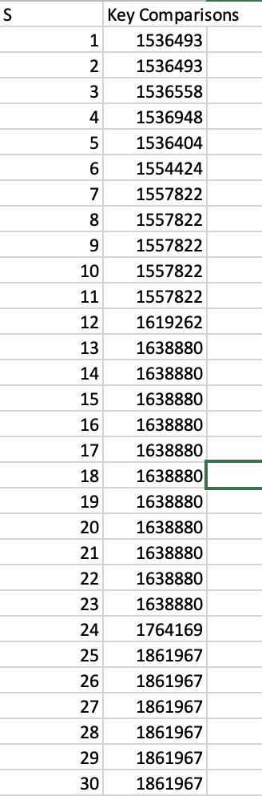
(c) ii) HybridSort on Dataset with input size fixed

Slide 26
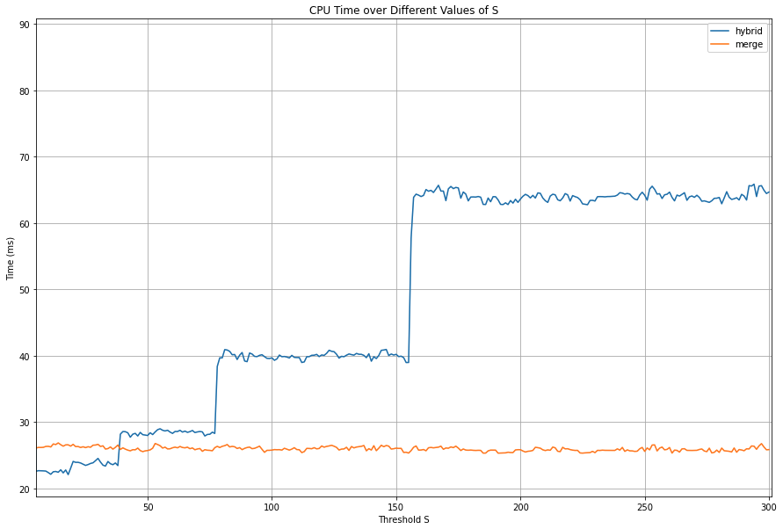
(c) iii) Obtaining Optimal S Value
Result: S = ~8
Notes:
In order to obtain the Optimal S value, we tested different values of S against CPU time.
It is rather obvious that Merge Sort is not affected by S.
We observe that as Threshold S is increased, so does the execution time for Hybrid Sort.
To get the Optimal S value, we continuously measured & averaged the value of Threshold S which would produce the minimal CPU Time.

Slide 27
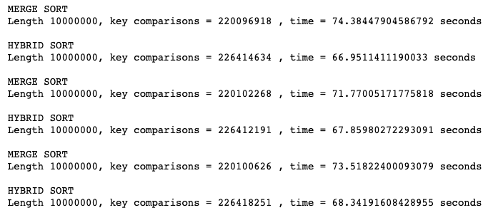
(d) Hybrid VS Mergesort
N = 10 Million
 | Hybrid (S = 10) | MergeSort
Avg Key Comparisons | 226,415,025 (higher) | 220,099,937 (lower)
Avg CPU Time | 67.717s (better) | 73.224s
Iteration 1:
Iteration 2:
Iteration 3:

Slide 28
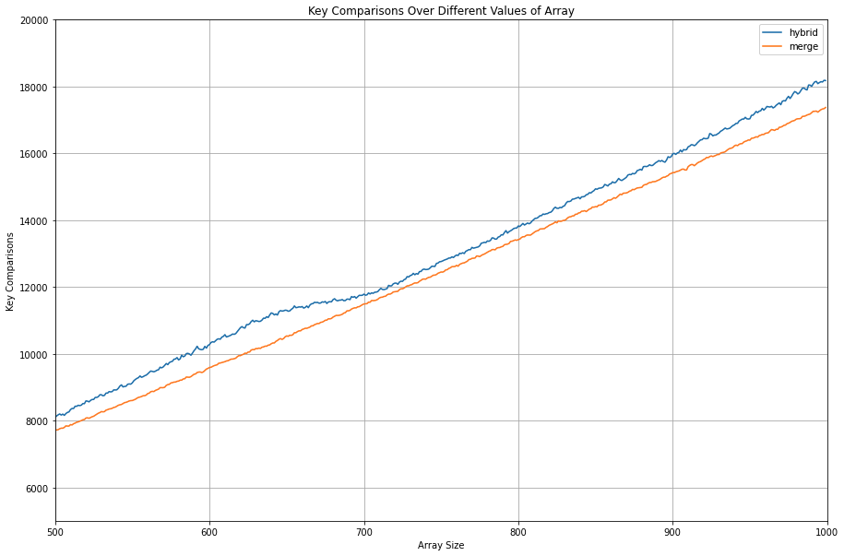
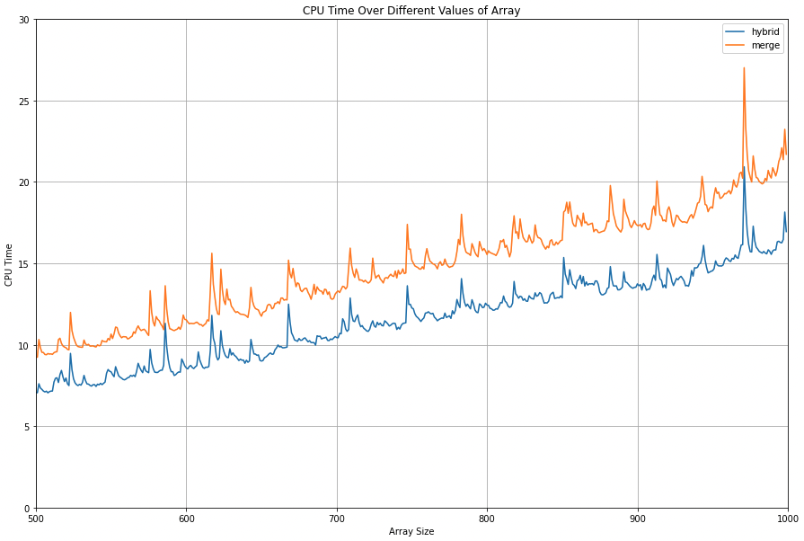
(d) Hybrid VS Mergesort
Hybrid Sort
Merge Sort
Key Comparisons
CPU Time
Notes:
Although Hybrid Sort has more Key Comparisons than Merge Sort
These graphs show that across all array sizes, Hybrid Sort almost always has a faster run time.

Slide 29
Conclusion
Merge Sort is more efficient than insertion sort for large arrays
With smaller subarrays, Merge Sort is inefficient due to the higher overhead during recursive Merge Sort calls
In comparison, Insertion Sort is more efficient for smaller subarrays, resulting in quicker execution time for smaller subarrays
By merging Insertion Sort & Merge Sort, execution time can be optimised
Although Hybrid Sort has higher key comparisons, it has a lower execution time

Slide 30
Thank You!

